Slide 1
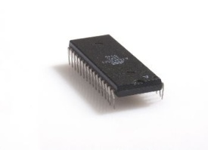
RX Path
TX Path
CRC ERR
EOF ERR
UART_SE
UART_PE
CheckSum
Rd Burst Len
DBG Command
CheckSum
TYPE Reg
8 bit
RAM 2
8 bit
MP Enc
UART TX
UART RX
MP Dec
RAM 1
WBS
8 bit
OR
8 bit
WBM
5
WBM
Host
(Matlab)
A
D
Z
INTERCON
INTERCON
X
1
WBS
TYPE
Reg
INTERCON
Mem Ctrl Wr
Mem Ctrl Rd
DBG ADDR
Reg
wr_cnt
wr_cnt_en
WBS
R2
R1
WBM
WBM
C
Y
B
2
SDRAM Arbiter
4
Display Controller
WBS
Pixel Manager
(Req for Data)
req_ln_trig
& Pixels, VSync
wr_rd_bank
Flush
Synthetic
Pic. Gen
Hsync,
VSync
Memory
Management
R1 – Ram 8→16 bits
R2 – Ram 16→8 bits
WBM
FIFO
VGA
Display
3
Flush
8 bit
Frame
Reg
WBS
E
MUX
VESA
Ctrl.
SDRAM Controller
Decompressor
IS42S16400 SDRAM
8 bit
Dual Clk FIFO
Disp. Reg
- 133 MHz
- 40 MHz
WBM – Wishbone Master
WBS – Wishbone Slave

Slide 2



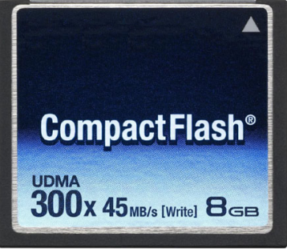
RS-232
FPGA
USB
Ethernet
Ethernet
RX Path
USB
RX Path
TX Path
Host
TX Path
RS-232
RX Path
TX Path
Displays
JPEG De-compressor
Display Controller
Memory Management
Memory Management
Display Controller
HD
MPEG De-compressor
Memory Management
VESA 640X480
Display Controller
Storage Devices
Run-Length De-compressor
VESA 800X600

Slide 3
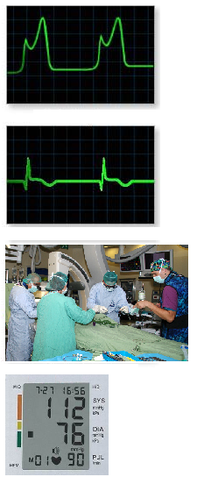
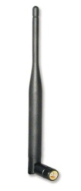

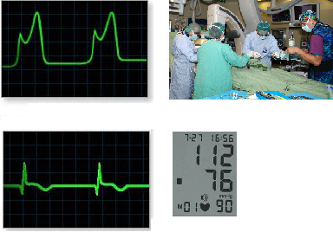

Run-Length
Encoder
FPGA with Extractors
Control Room
Run-Length
Encoder
MPEG
Encoder
SDRAM
JPEG
Encoder

Slide 4
TX Path
RX Path
MessagePack
Decoder
MessagePack
Encoder
CheckSum
UART RX
CheckSum
UART TX
WBS
WBM
5
WBM
Host
(Matlab)
A
D
Wishbone
INTERCON
WBM – Wishbone Master
WBS – Wishbone Slave
1
WBS
Mem Ctrl Wr
Mem Ctrl Rd
WBS
WBM
WBM
B
C
2
SDRAM Arbiter
4
WBS
Display
Controller
Memory
Management
WBM
Run-length
De-compressor
VGA
Display
3
VESA
Ctrl.
WBS
E
SDRAM Controller
Dual Clk FIFO
IS42S16400 SDRAM
- 133 MHz
- 40 MHz

Slide 5
RX Path
TX Path
WBS
WBM
WBM
Host
(Matlab)
WBM – Wishbone Master
WBS – Wishbone Slave
Wishbone
INTERCON
WBS
WBS
Display
Controller
Memory
Management
VGA
Display
WBM
WBS
WBM
WBS
WBS
SDRAM Controller
Image Manipulation
IS42S16400 SDRAM
WBM

Slide 6



Modular
De-Compressor
(JPEG)
Compressed
Data
Message Decoder
Modular
De-Compressor
(MPEG)
Display
Controller
Modular
De-Compressor
(Run-Length)

Slide 7
8 bits
SOF
1 Byte
Type
1 Byte
Address
1 Byte
Data Length
2 Bytes
Data (Payload)
Up to 1 KByte
(2 SDRAM’s full page)
CRC
1 Byte
EOF
1 Byte

